Slide 1
Getting Git, MSVC, CMake
Dr. Scott Nykl
CSCE593

Slide 2
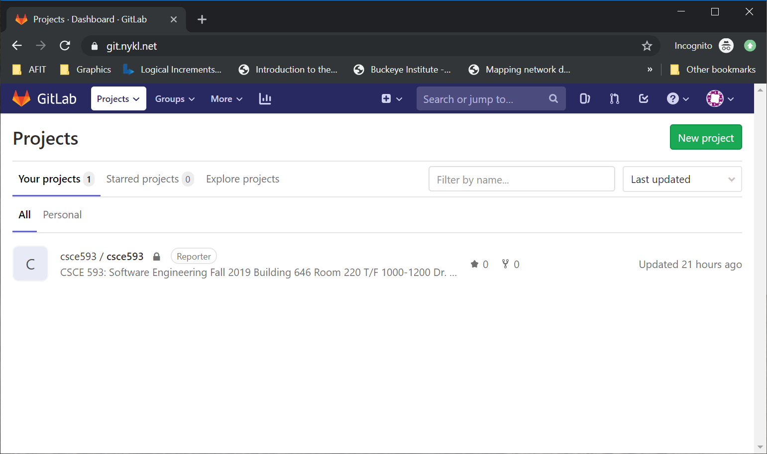
Login to https://git.nykl.net
Username is first.last (as in first.last@afit.edu)

Slide 3
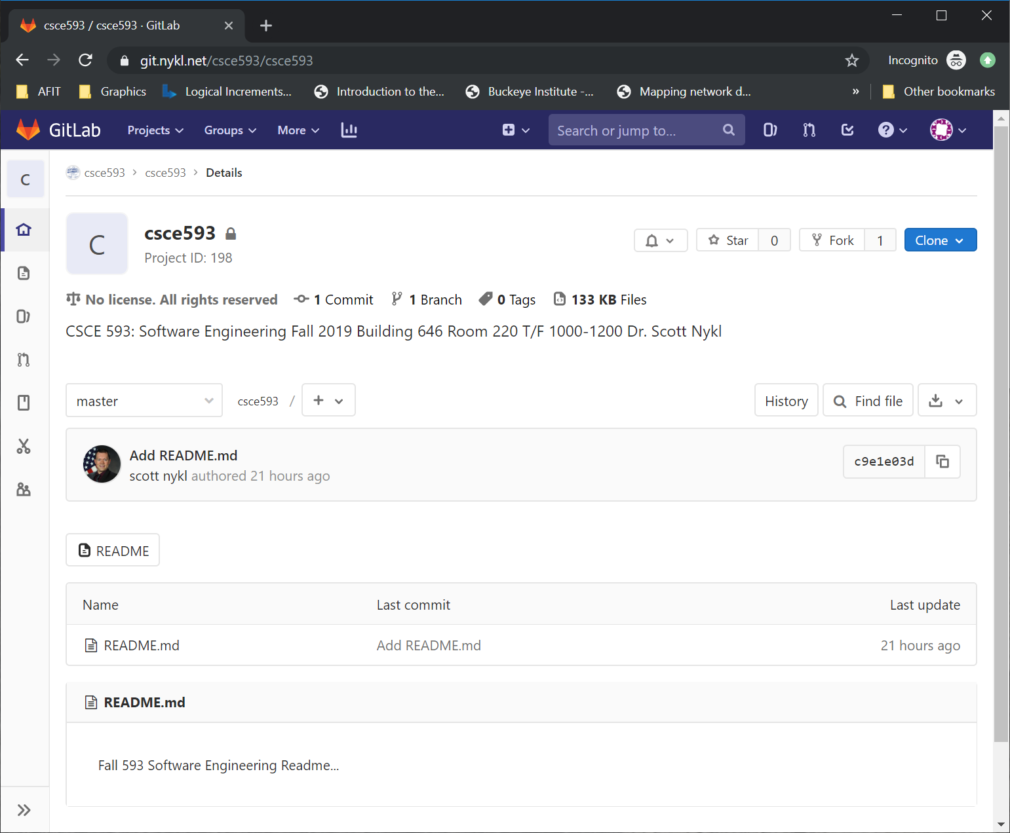
Fork csce593/csce593

Slide 4
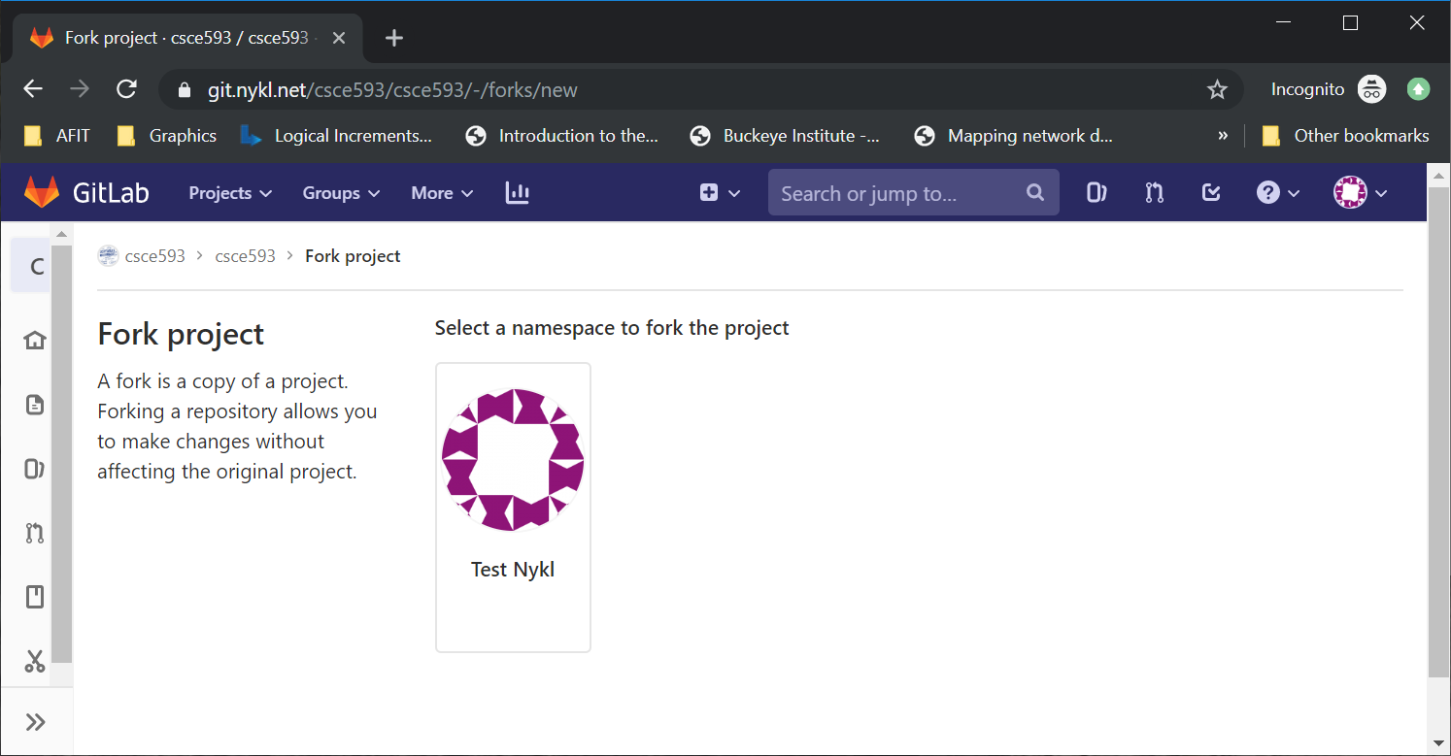
Confirm Fork

Slide 5
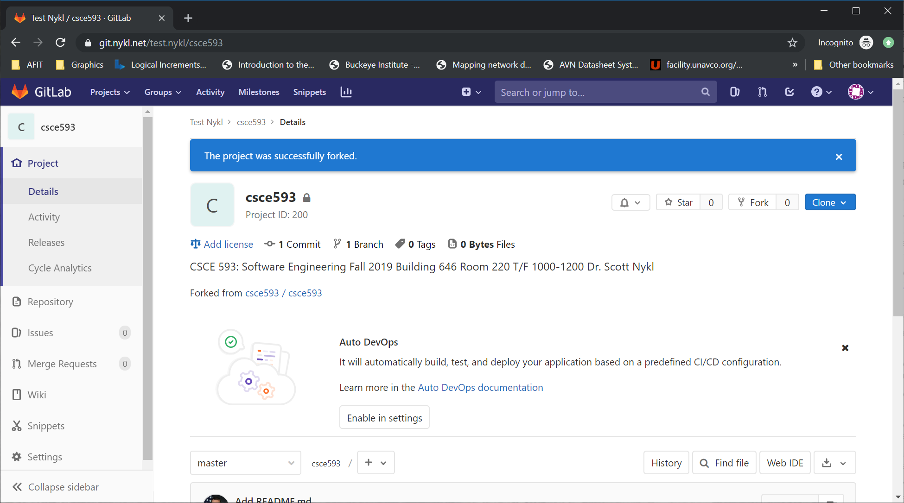
Confirm Success

Slide 6
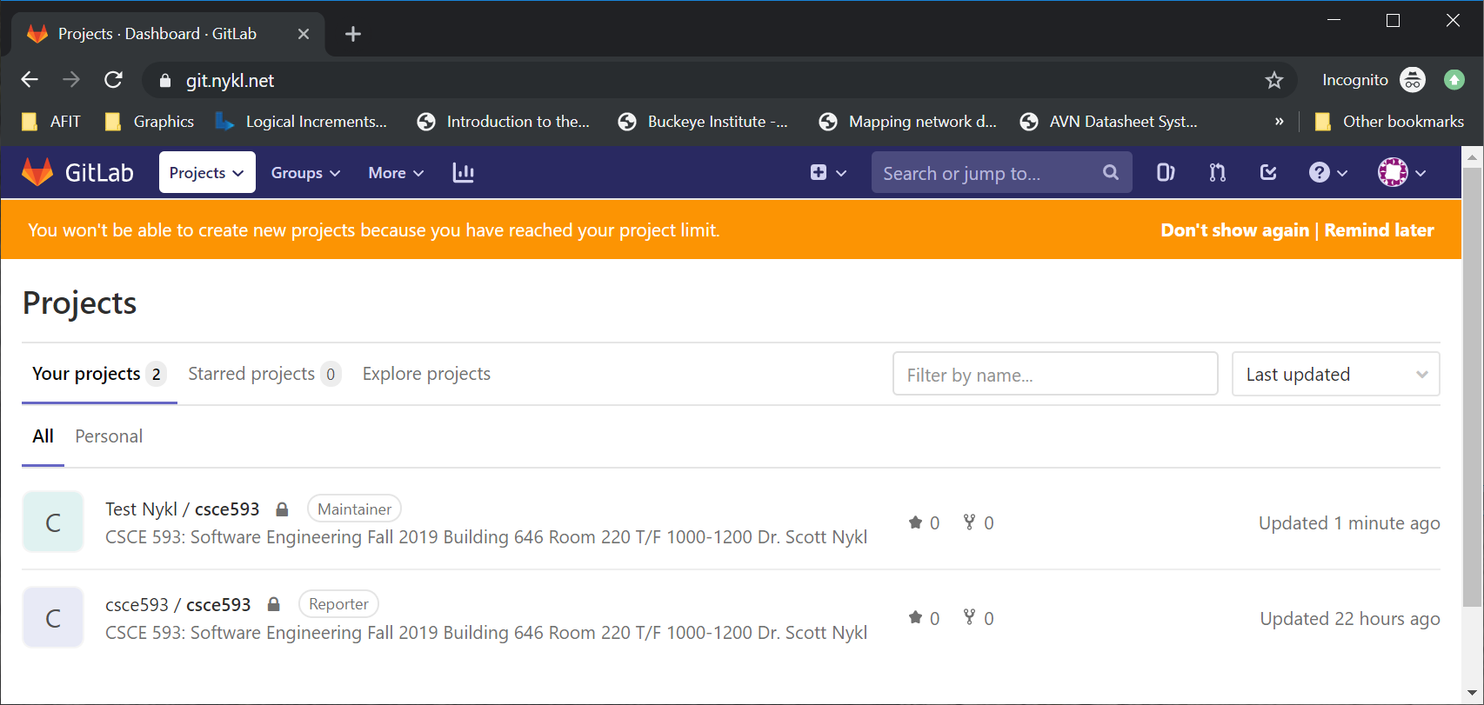
Now 2 Projects Exist!

Slide 7
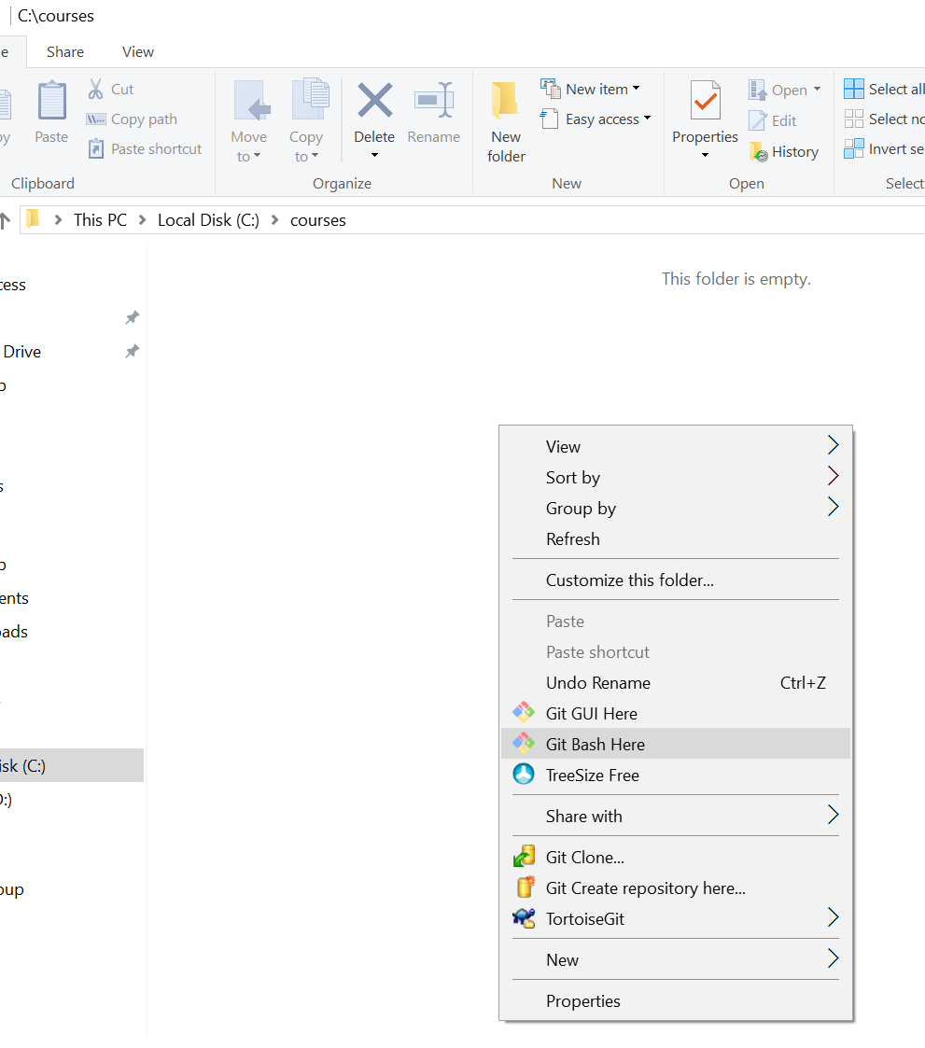
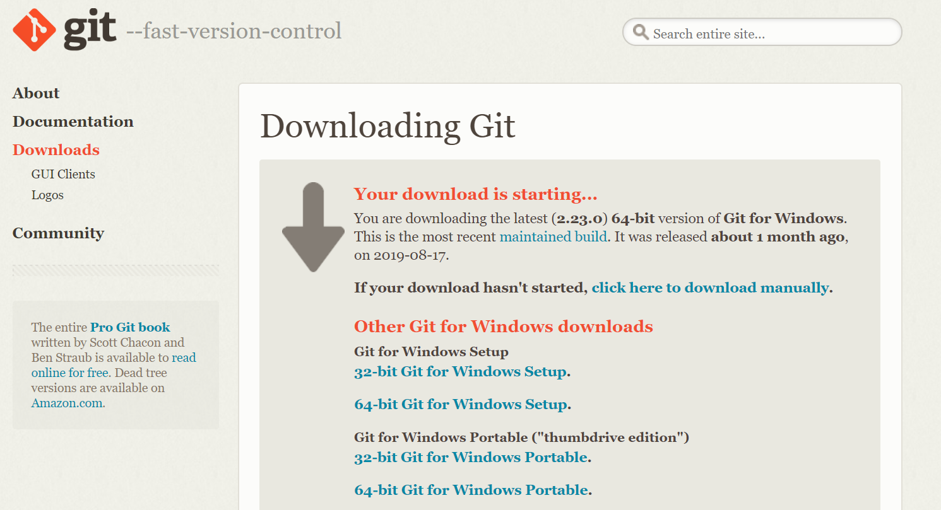
Setup GIT on Your Machine
https://github.com/git-for-windows/git/releases/download/v2.23.0.windows.1/Git-2.23.0-64-bit.exe

Slide 8
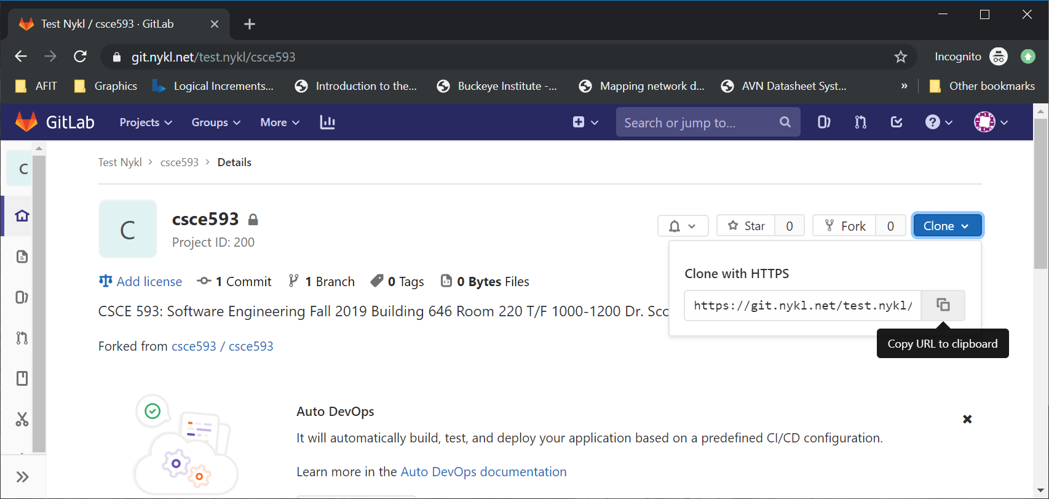
Copy URL to Your Forked Git Repo

Slide 9
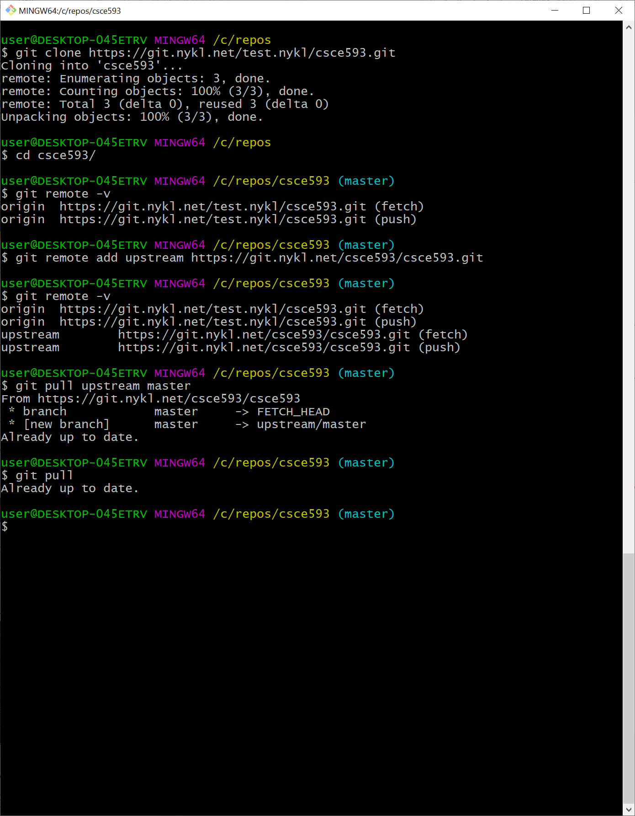
Your Username here
Clones files from your forked repository to your local hard drive at /c/courses/csce593
Tells your local repository to add an upstream branch (pointing to the original repo from which you forked). This way, when I add new files to that repo, you can pull them into your forked repo.
View all remotes associated with your local repository
Pull latest files from the upstream (original, non-forked repo) into your local repo. You may then push these files to your forked repo on the server via git push.
At a later time, the professor will add content to repo. The student (you) can immediately get this new information by pulling from the upstream repository on the master branch. i.e., git pull upstream master

Slide 10
What to Download & Install
GIT for Windows (latest 2.23.0) https://git-scm.com/download/win
Nice GUI Front End for GIT TortiseGIT https://tortoisegit.org/
CMake 3.15.3 – Cross platform build tool https://cmake.org/download/
MSVC 2019 C++ Compiler & IDE https://visualstudio.microsoft.com/vs/

Slide 11
DO NOT List
Do *NOT* commit temporary Files or Folders to Repo (wastes space)
Do *NOT* add frequently changing binary files to repo (no exes or objs or vcxproj or sln or cwin64/ (will conflict with group members)

